Slide 1
Rental341
Team341
Hrag Bankian
David Cohen
Johnny Dang
Élian Gadbois-Roy
Sevag Merdkhanian
Harun Slahaldin Omar

Slide 2


Customer: Problems
Hidden fees
Limited transparency
Unintuitive reservation process
Inconvenient pick-up and drop-off procedures

Slide 3


Rental Agency: Problems
Increasing competition
Complex inventory management
High operational costs

Slide 4


Solution
Streamlined reservation process
Intuitive UI
Clarity and transparency

Slide 5
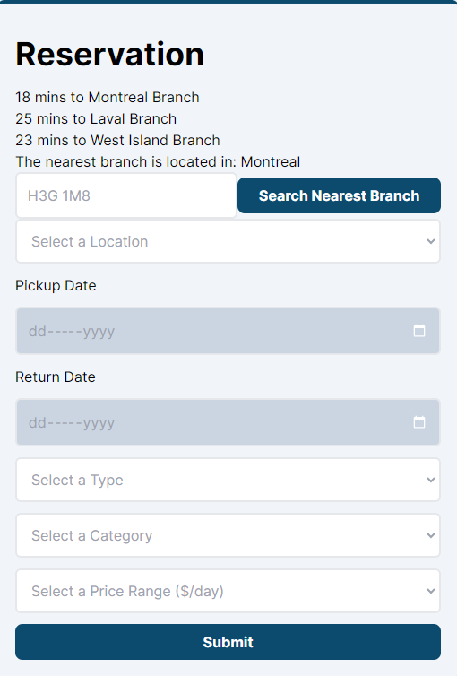

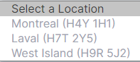
Why Rental341?
Secure payment system
Easily select a branch
Quick and convenient

Slide 6


Rental341 Quiz

Slide 7



Product Overview

Slide 8

Product Overview
≈ 3000 lines of code
12 web pages

Slide 9
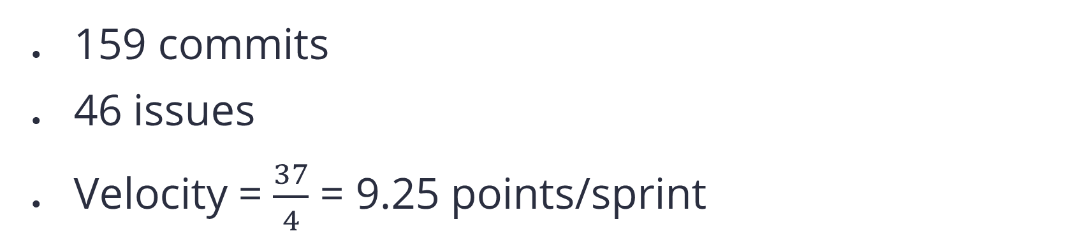
Process Overview
159 commits
46 issues
Velocity = $\frac{37}{4}$ = 9.25 points/sprint

Slide 10
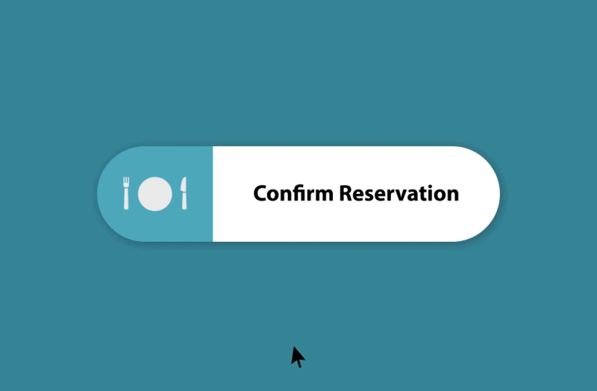

Slide 11
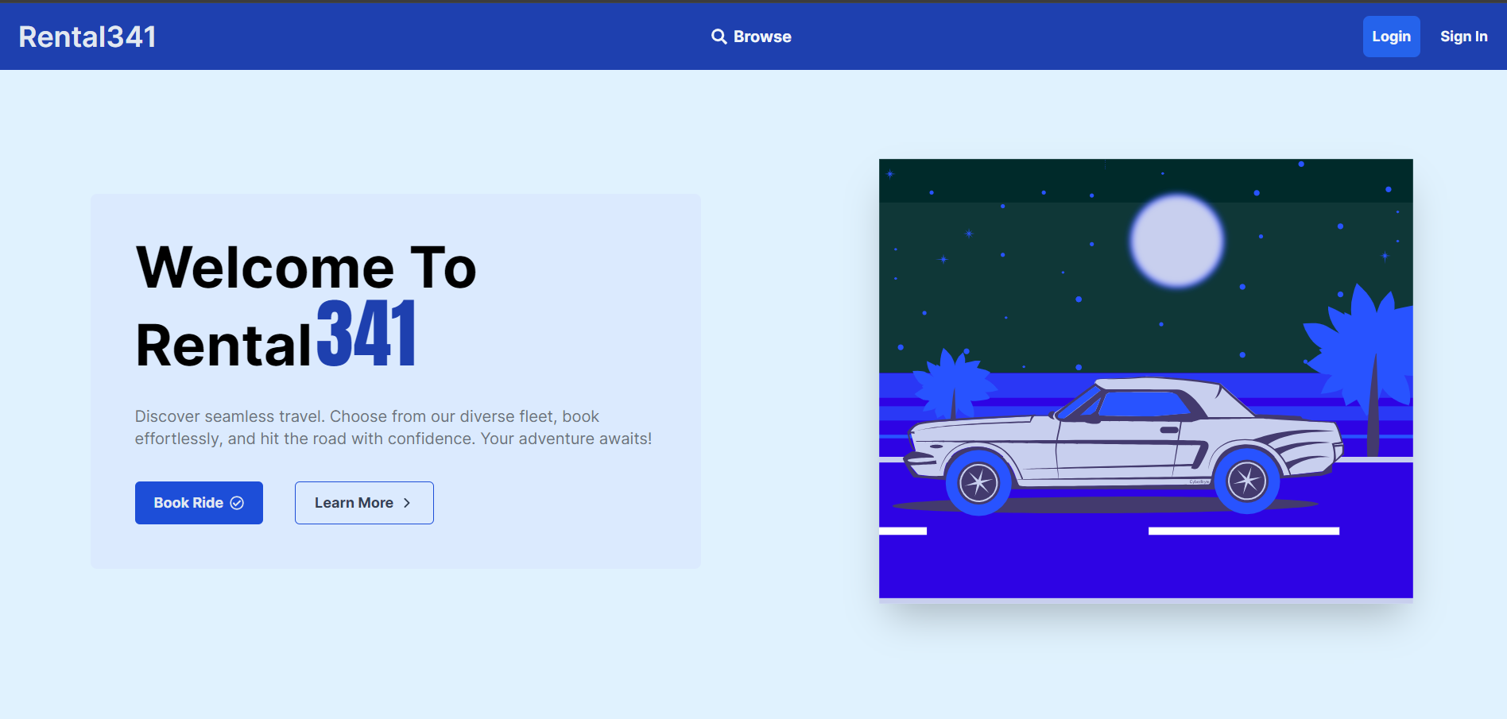

Slide 12
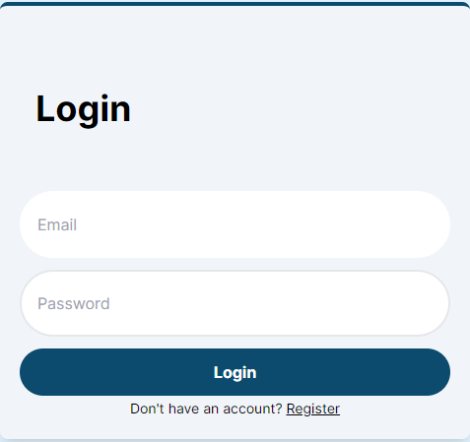

Slide 13
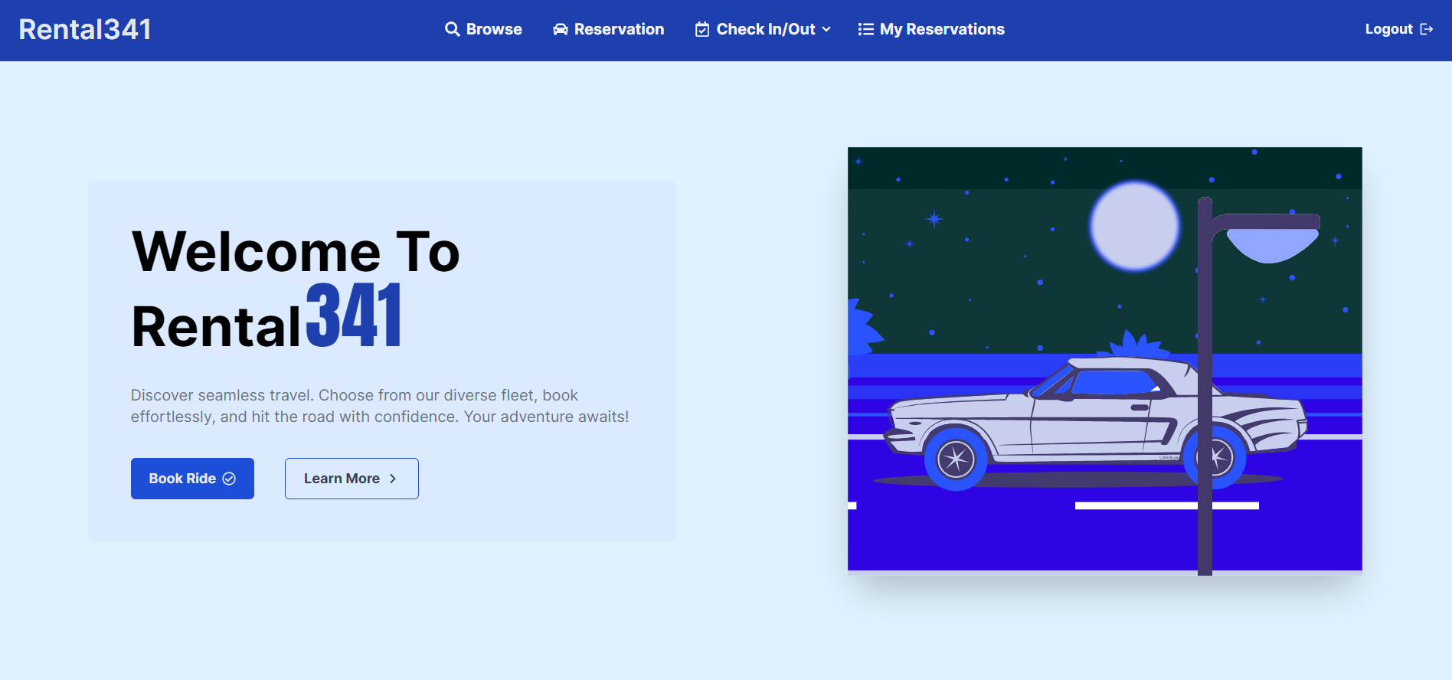

Slide 14
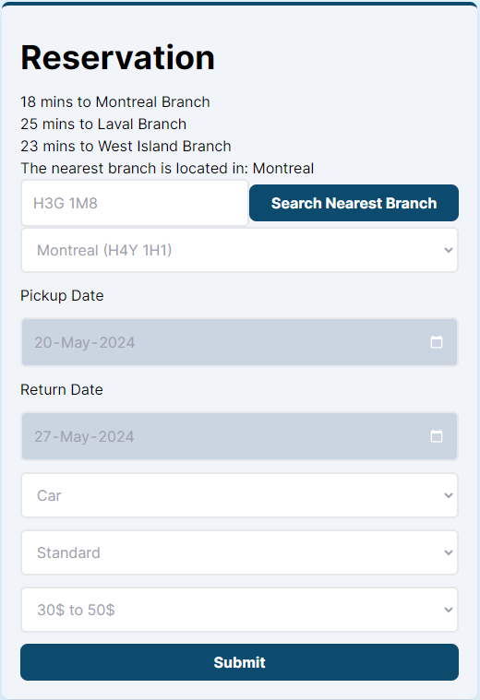
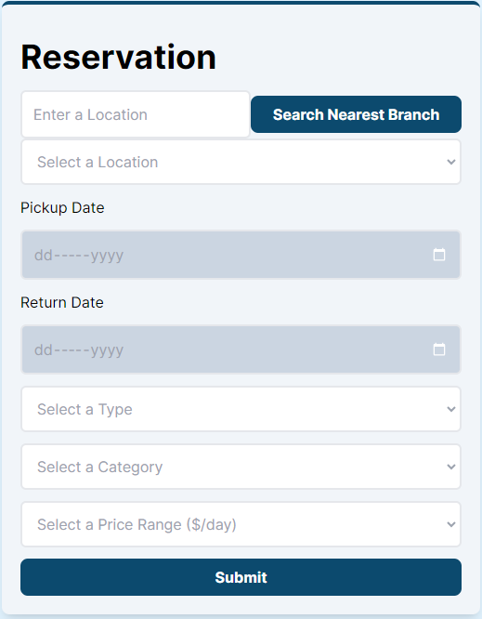

Slide 15
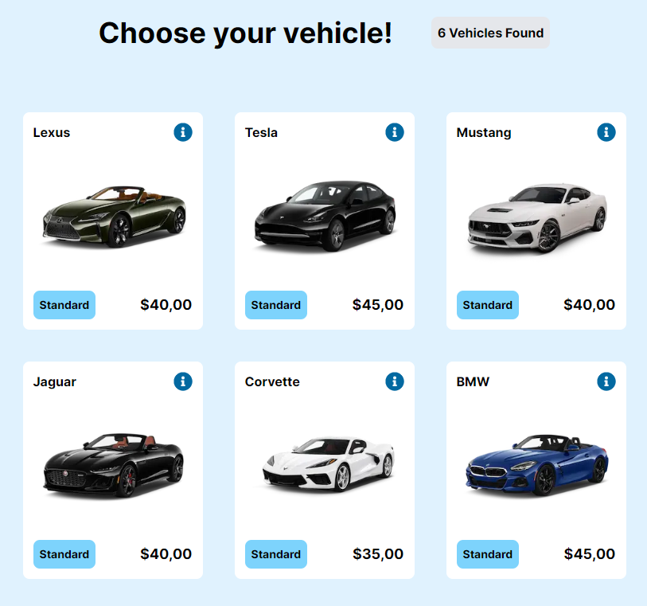

Slide 16
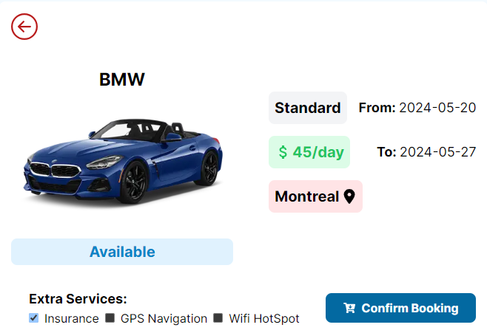

Slide 17
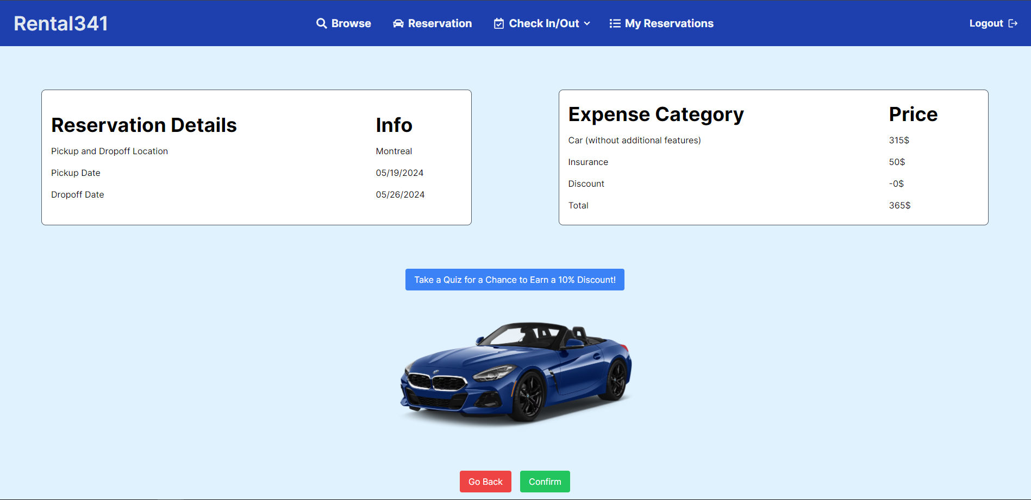

Slide 18
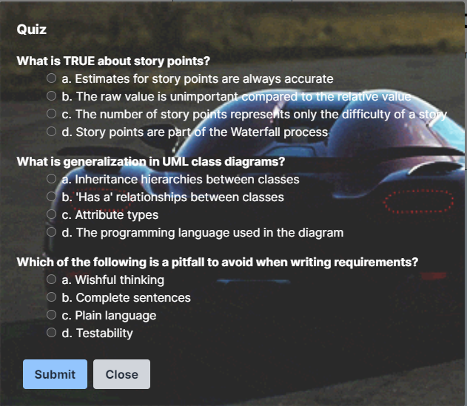
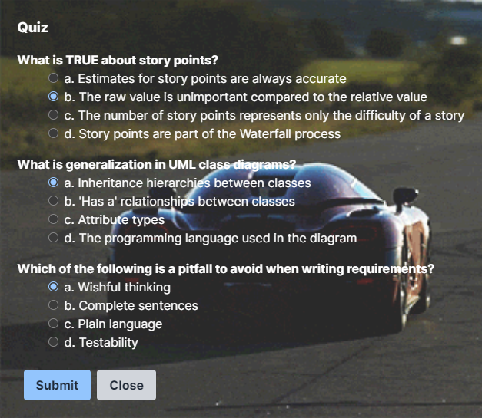

Slide 19
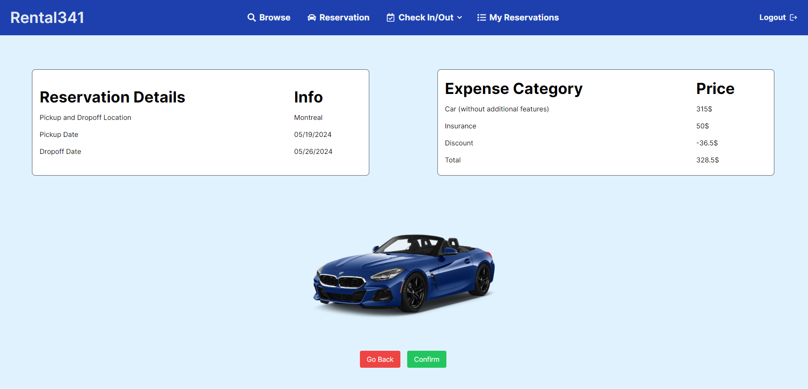

Slide 20
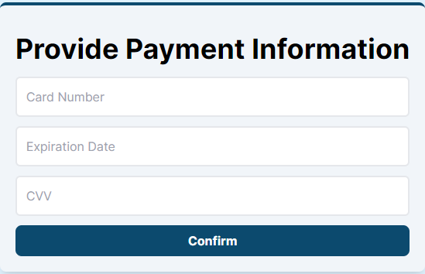
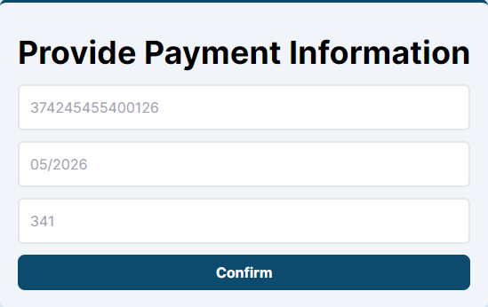

Slide 21


